Slide 1
Visualizing Reader Preferences on Goodreads
Brian Choi

Slide 2
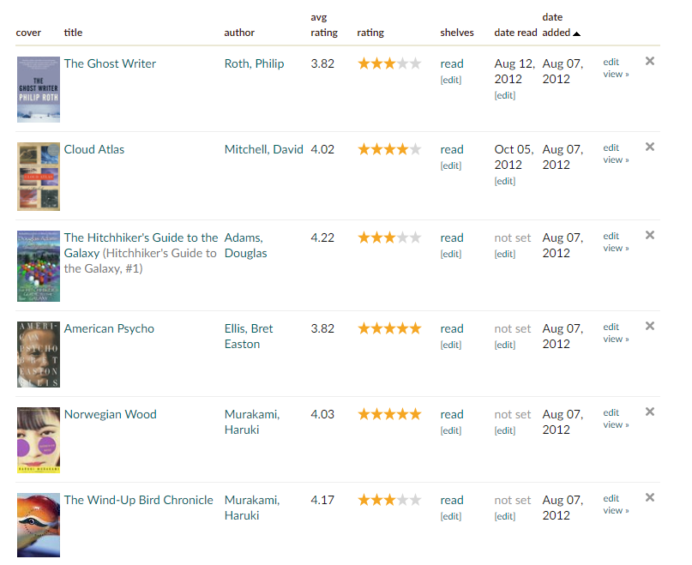
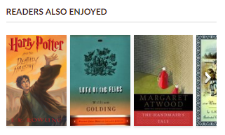
Introduction
Goodreads is a social cataloging site for books
Can catalogue and rate all the books you have read and share them with friends
Can look up almost any book ever published and see how other people have rated them
Integrated with Amazon and serves as an excellent way to discover new books through recommendations.

Slide 3
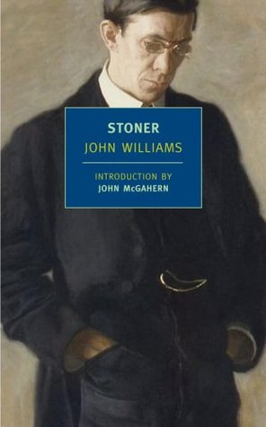
Motivation
I was a (moderately) avid reader and used Goodreads extensively to find new books.
Always loved the classics and split a lot of my reading between classics and contemporary novels.
Wanted to explore the popularity of classics compared to contemporary novels and see if classics are still read today.
Main focus is on the relationship between date of publication, number of ratings (popularity), average rating of book on Goodreads, and books/authors.
Topics considered but chose not to pursue:
Genres/Tags
Recommendations/Similarity
My all-time favorite book

Slide 4


Use Cases
Project is mainly targeted at book publishers, users of Goodreads, or simply anyone who enjoys reading.
Can use to discover what the most popular and highly rated books and authors on Goodreads are and how they compare to other books and authors.
Goal is discover, enjoy, search, and enjoy!
Not machine learning or recommendation based
Simply a way for users to find out more about their favorite books.

Slide 5
Dataset (https://github.com/zygmuntz/goodbooks-10k)
The data was acquired from Github through user Zygmuntz’s account
He scrapped the data from Goodreads and graciously provided data for recommendation system practice.
Data set consists of the 10k most popular books on Goodreads as of 2017.
Also contains 6 million user ratings but not used because more for recommender system purposes.
All books combined contains over 540 million ratings so user ratings scrapped is only small subset.
Data set contains five tables: books, book_tags, ratings, tags, to_read
For purposes of this project, only book is used.
Tag somewhat relates to genre which isn’t purpose of these visualizations.

Slide 6
Dataset - Data Wrangling
Native features used: author, title, original_publication_year, ratings_count, ratings_1, ratings_2, etc.
Additional features like ISBN and image_url were not important. Image_url was considered to make scatter points prettier but did not want to require access to internet or to mass download images.
Added features: average_rating (weighted), main_author, nth_release, period
Additional grouped features also added for some visualizations such as most popular books by year and most popular book by author.
All data preprocessing was done using Pandas and Numpy to easy integration with Bokeh.

Slide 7
Tasks
Among today’s readers, how popular are classics compared to contemporary books?
What are the most popular books of all time and is there a relationship between popularity and average rating on Goodreads?
Are certain periods of literature better regarded than others? How do 19th century books stack up against contemporary 21st century books and 20th century books?
Who are the most popular authors? Are the most popular authors also the most prolific or highly rated?
How do authors’ careers evolve over time? Which authors tend to hit their “peak” at certain points and which authors tend to have steady popularity throughout their entire career?

Slide 8
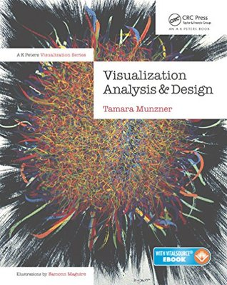
Overview
A visualization was created for each task, giving a total of five visualizations.
Heavy EDA was needed and took a large amount of my time.
Trends were not easy to find and took a bit of analysis to discover interesting things to plot.
Wanted to focus specifically on time vs popularity or time vs rating.
Bokeh was used to create the visualizations.

Slide 9
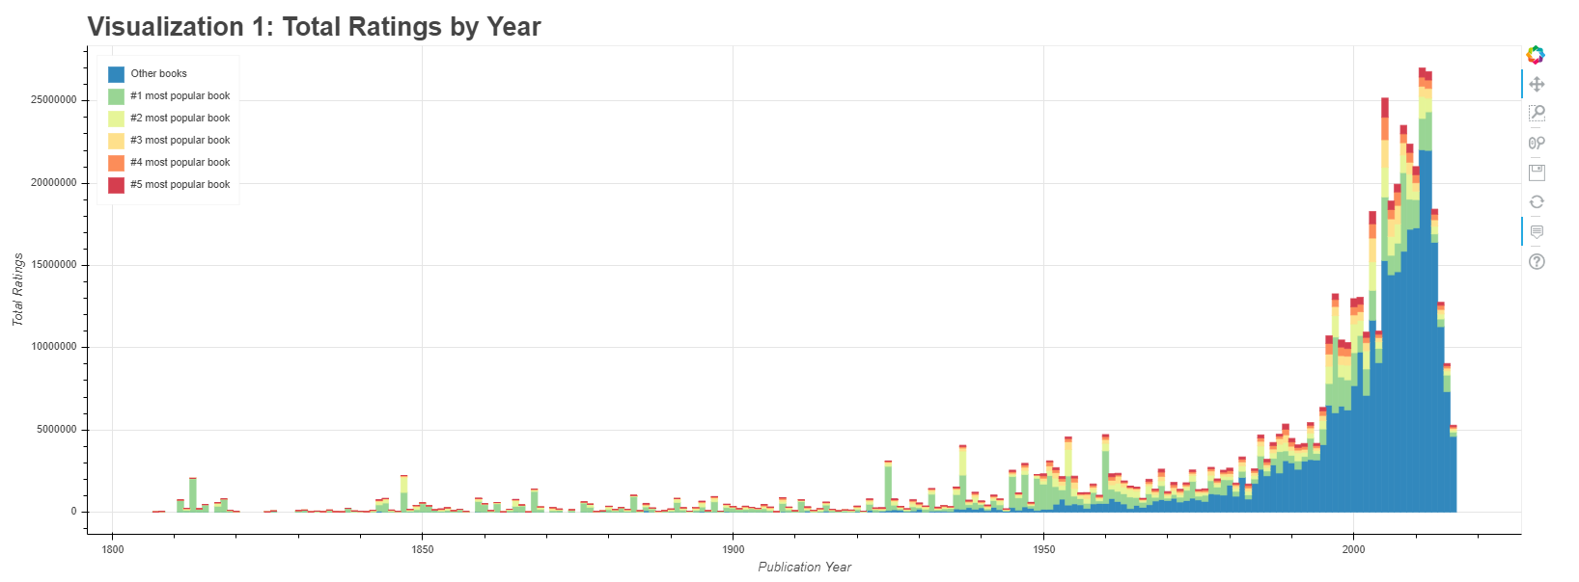
Visualization 1

Slide 10
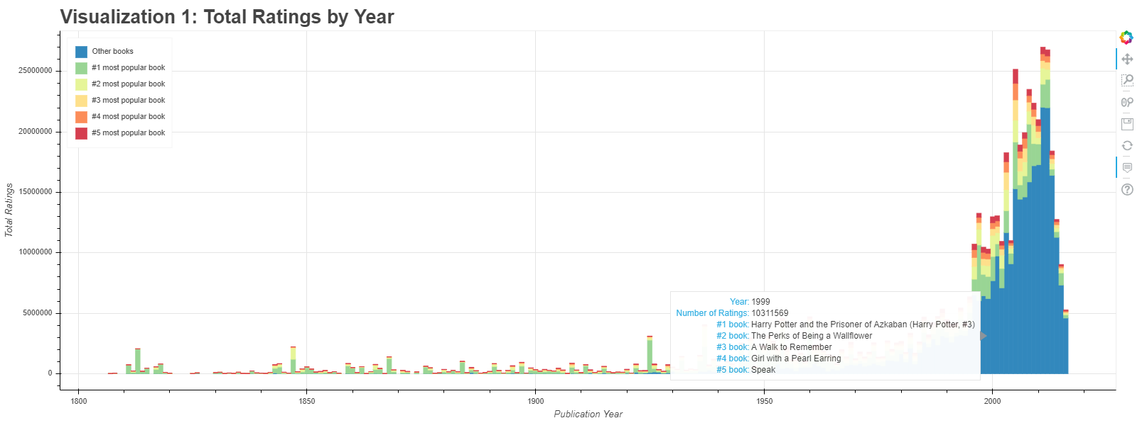
Visualization 1: Solution
Stacked bar plotting publication year vs total ratings count per year.
Colors indicate top 5 most popular books and all other books published that year.
Hovering over bar shows year, total ratings count for that year, and the top five most popular books.
Linear axes
Years 1800-2017 only
Discrete color map with blue as “other” to separate from green->red.

Slide 11
Visualization 1: Findings
Immediately obvious that newer books are significantly more popular than older books.
Bar graphs, when evenly spaced with linear axes, also gives the ability to sum up areas visually.
Can tell by glancing at 1990-2017 that total area is far greater than 1800-1990.
Earlier years, particularly before 1980, also have much less blue than later years.
Blue = other books. This means that earlier years are dominanted by 3-5 books. Many older books, “classics”, have fallen out of popularity or have simply been forgotten by time.
Example: To Kill a Mockingbird occupies about 75% of all ratings in the year 1960.

Slide 12
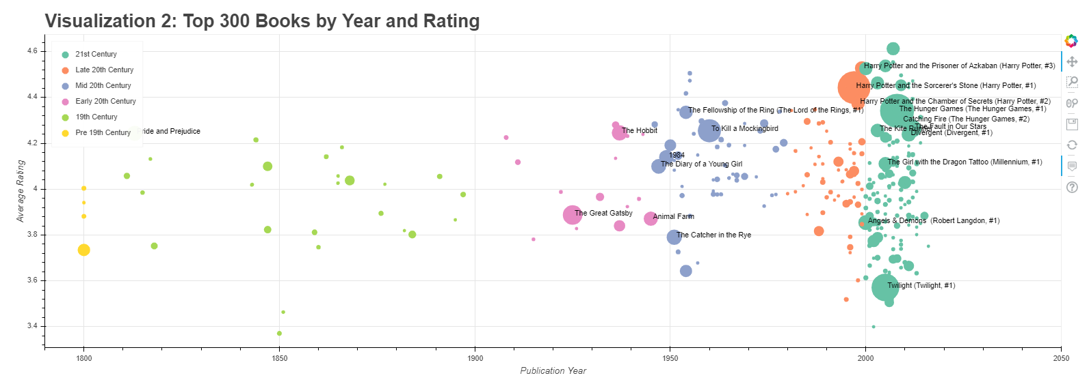
Visualization 2

Slide 13
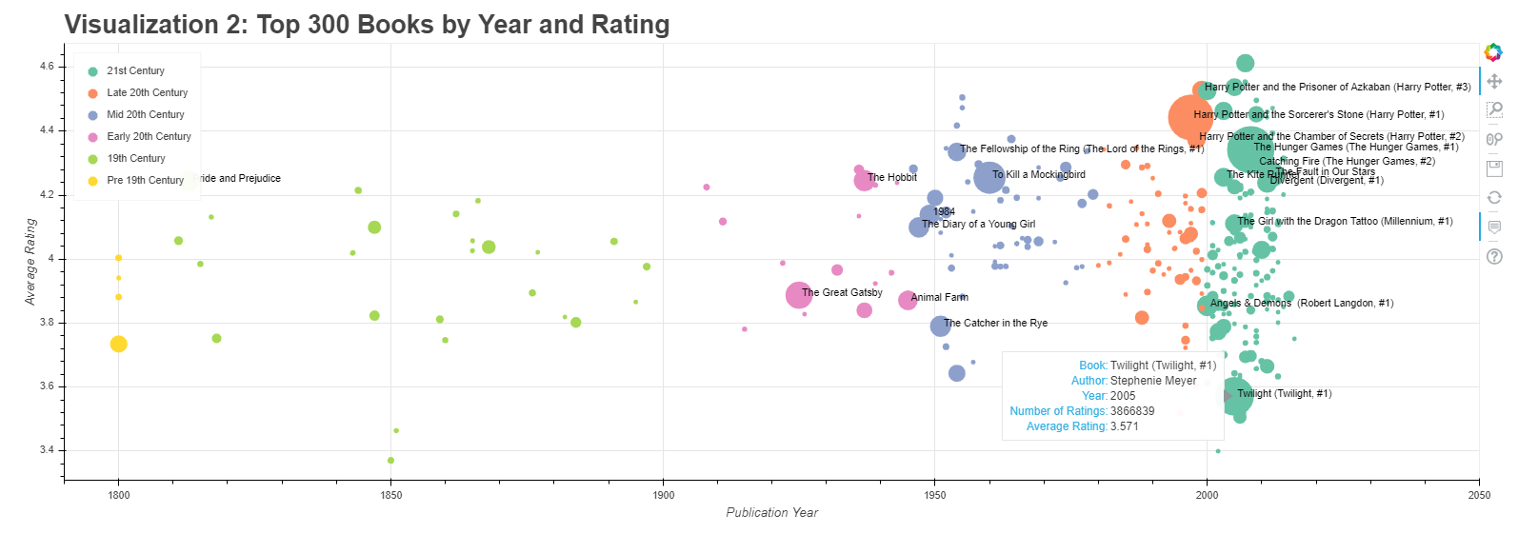
Visualization 2: Solution
Scatter plotting book publication year vs average rating.
Only top 300 books are plotted.
Both because the focus is on the most well known popular books and also to reduce clutter.
Reduction major technique employed for many of these visualizations
Size channel to indicate popularity of book. Radius is scaled linearly.
Color map to indicate period that book was published.
Tooltip important here to find which books are which.
Most popular books are labeled to give context.
Zoom to view hidden points.

Slide 14
Visualization 2: Findings
The visualization shows very clearly how much more popular the most popular books are compared to the 200th-300th most popular.
Harry Potter, Hunger Games, Twilight, The Great Gatsby, To Kill a Mockingbird
Linear scaling of radius allows direct comparison of most popular vs less popular.
Popularity does not always equal high regard.
Example: Great Gatsby and Animal Farm both score under 4 (mean) despite being some of the most popular books ever written.
Reinforces point that newer books are significantly more popular than older books.
Periods are subjectively defined but still give insight when trying to categorize books.

Slide 15
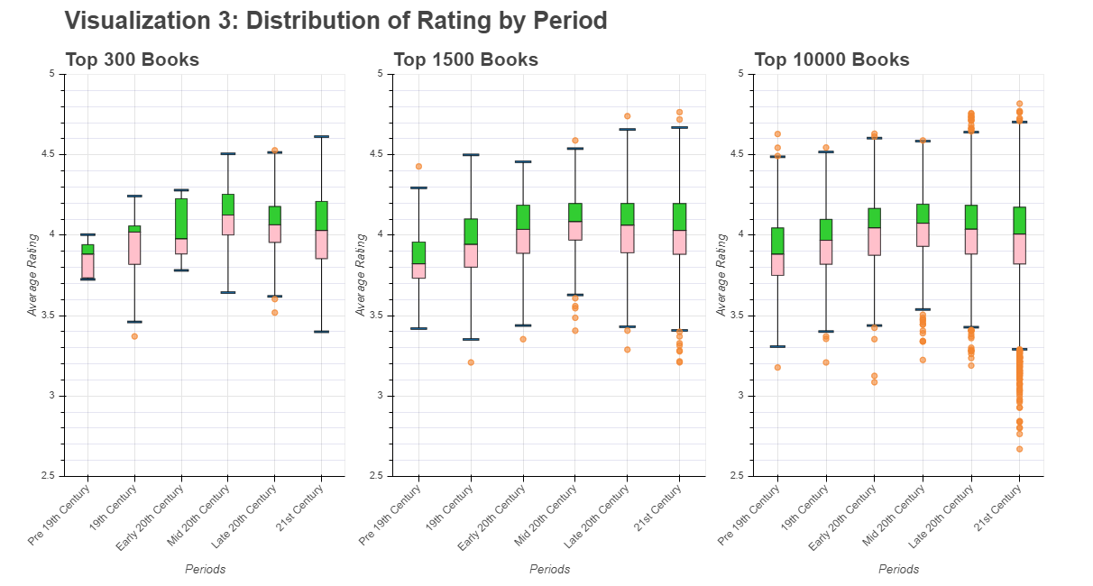
Visualization 3

Slide 16
Visualization 3: Solution
Box and whisker plot showing the distribution of ratings for each period.
Contains all the basic aspects of a box and whisker plot:
Boxes = median, 75th percentile, 25th percentile
Stems and whiskers = Extreme edges, usually defined as 75th/25th +/- 1.5*IQR
Points = outliers. Points that exist outside of the whiskers aka really good or really bad books
Plotted for top 300 books, top 1.5k books, and top 10k books.
Three plots to show how distribution changes as different levels of popularity is applied.
Uses same period categories from viz 2.
Intended to expand on points from viz 2 and give bigger picture thru statistics.

Slide 17
Visualization 3: Findings
Distributions show that older books are generally less well regarded amongst Goodread users than newer books, particularly from late 20th century and 21st century.
Could it be because of younger users who have a natural distaste for Shakespeare and Dickinson?
Even then, average rating range is fairly tight, with extreme ranges being no greater than 3.3 and 4.6.
Lots of outliers in lower extremity of 21 century. Could symbolize lower quality pulp fiction that is popular but not considered good writing.
Box and whisker plots generally good for bringing a story together and making conclusions that other visualizations might simply only be alluding to.

Slide 18
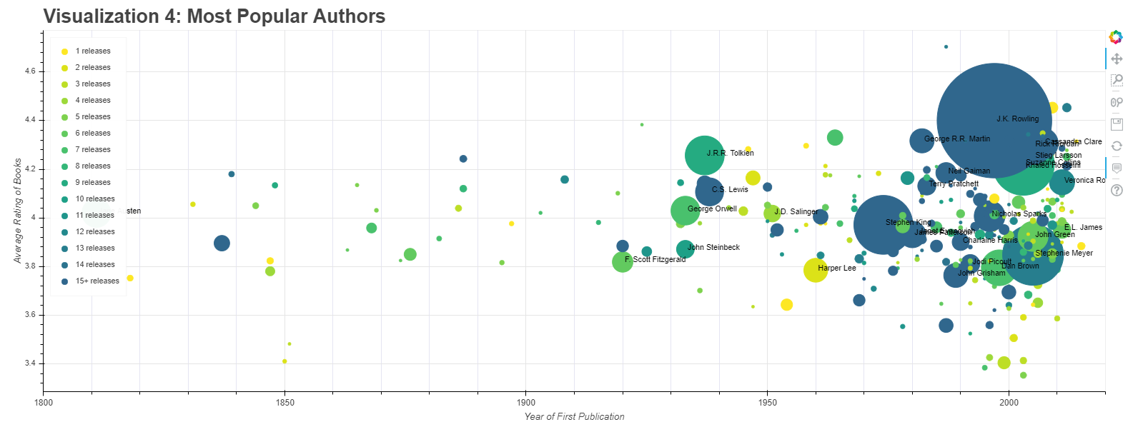
Visualization 4

Slide 19
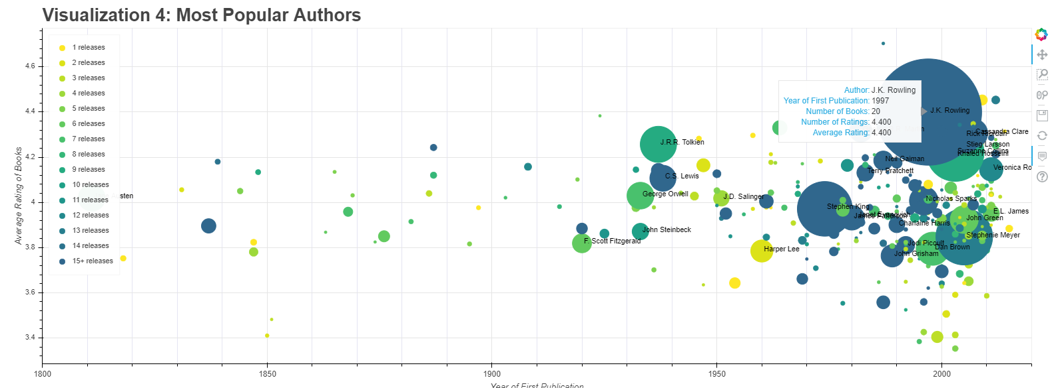
Visualization 4: Solution
Similar to visualization 2, uses scatter plot to show year of first publication vs average rating of authors.
Uses same channels as viz 2: size + color
Main difference is that color now encodes number of books published.
Therefore, a relationship between darker colors and larger circles can be established alongside year and average rating.
Zoom interaction important here as larger circles can occlude smaller ones

Slide 20
Visualization 4: Findings
Similar to visualization 2, newer authors are by far more popular.
The scaling in this plot compared to viz 2 show that when ratings are aggregated, authors like J.K. Rowling are even more dominant than other authors.
Again, popularity does not necessarily correlate to higher average rating. In fact, no real correlation can be seen except that the highest rated authors do tend to be highly prolific.
Color
Color map used shows what should be an obvious correlation between number of books published and total popularity (number of ratings) but the relationship is not 1 to 1.
Color map also allows smaller circles to sit on top of larger ones, giving clarity to circles that would have otherwise been hidden with viz 2’s color map.

Slide 21
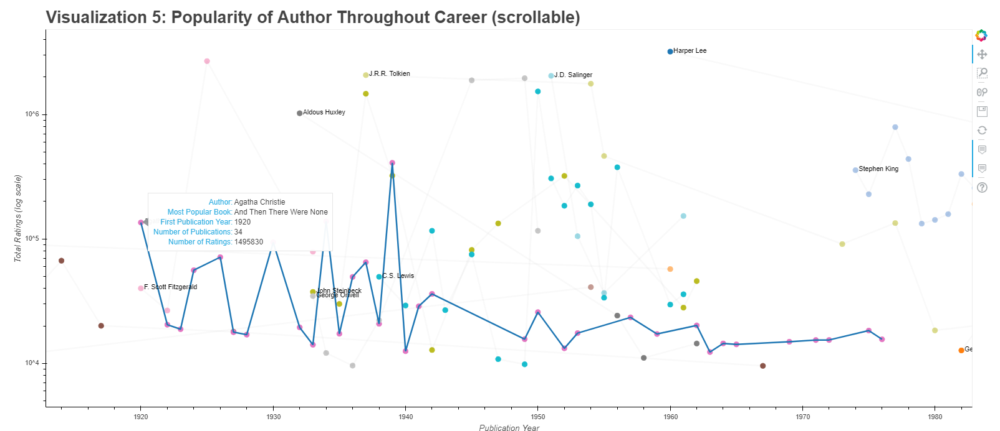
Visualization 5

Slide 22
Visualization 5: Solution
Line + Scatter Plot that tracks the progress of an author’s career.
Each point represents a book released by an author and the number of ratings it got on Goodreads (popularity).
Number of ratings are log scaled.
Important here because of large difference in # ratings
Color used to differentiate authors
Hovering over author will highlight path of author’s career.
Also show basic author statistics.
Example: Agatha Christie
Only shows top 30 or so authors.

Slide 23
Visualization 5: Findings
The most popular authors tend to find their greatest success early in their career.
With the exception of Agatha Christie and Arthur Conan Doyle, the most read 19th century/early 20th century authors tend to mainly focus on a couple important works while late 20th century/21st century authors tend to be more prolific.
The vast majority of major authors tend to have one or two books that define their entire career (Dostoyevsky’s Crime and Punishment and Brothers Kara..)
Thought hard about best choice of idiom for this plot.
If had to do again, might use multiple line plots instead to reduce clutter.
Clutter is a major limitation since adding more than 30 authors will result in hundreds of points and criss crossing lines. Need to find a better idiom and still somehow preserve temporal attribute.

Slide 24
Demo

Slide 25
Questions?

